Slide 1
Assignment 3
Kyryl Masalov 01/12/2023

Slide 2
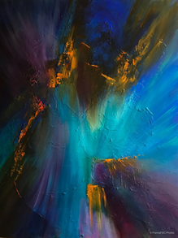
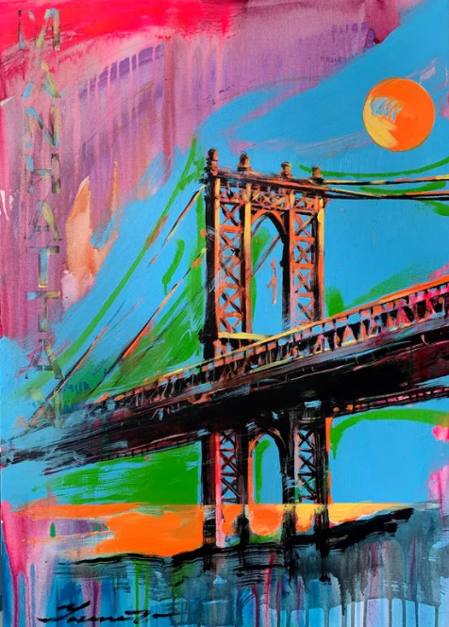


Sources and where I got them from...
Asset Name | Source link and where is located in the presentation | How It looks like | Asset type | Why you want to use it?
Blue Lagoon | https://www.singulart.com/en/artworks/fran%C3%A7oise-dugourd-caput-blue-lagoon-298195 I use this image in Home and Shop page on slide 7 and 8 |  | Image | Because it is one of Yaroslavs arts and I think It looks quite good to be located on my website.
Manhattan bridge | https://www.singulart.com/en/artworks/yaroslav-yasenev-bright-painting-manhattan-bridge-usa-urban-art-manhattan-bridge-street-art-new-york-city-1799060 I use this image in Home and Shop page on slide 7 and 8 |  | Image | This image is one of the best Yaroslavs work so I added it to show his skill of drawing.
Arts-Logo | https://blogs.umflint.edu/artexhibition/arts-logo/ I use this image in Products page on slide 11 |  | image | this logo makes it clear only by its appearance that after clicking this button the user goes to a site related to artwork.
Craft-Logo | https://app.logo.com/editor/colors?logo=logo_fb144154-b8ba-4e46-a40e-7935daae1025&_gl=1*1kbk97w*_gcl_au*NzY2MzYwNzY3LjE2OTgxNjY4MTI. I use this image in Products page on slide 11 |  | Image | Simple, but beautiful logo, which gives immediately understand the result of clicking on the link to the page.

Slide 3

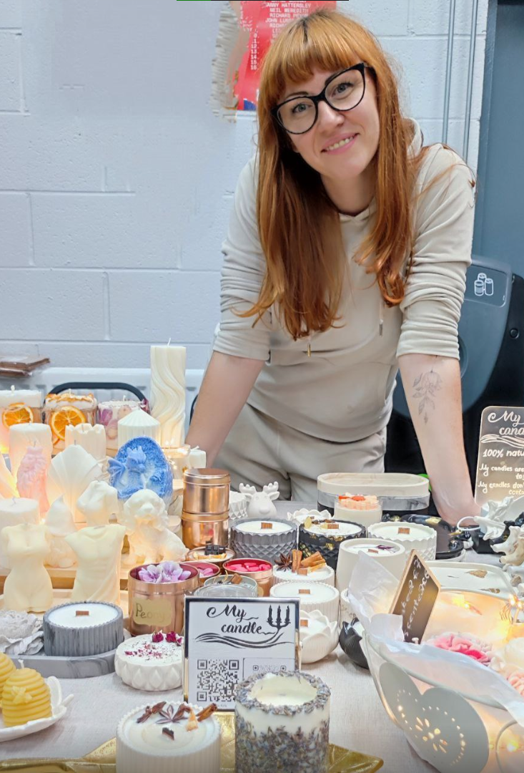



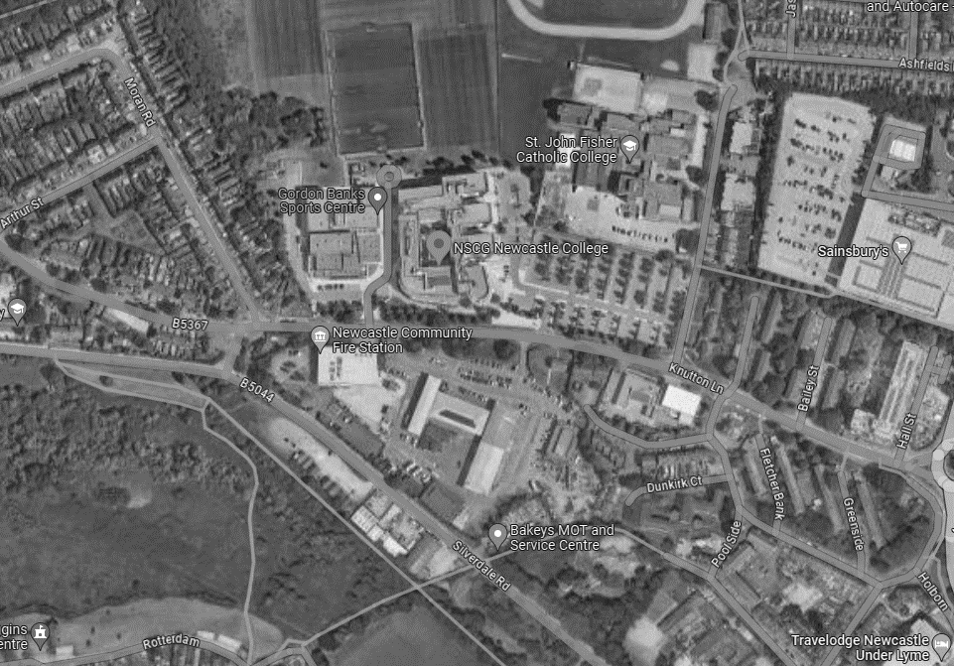
Asset Name | Source link and where is located in the presentation | How It looks like | Asset type | Why you want to use it?
Yaroslav | https://www.singulart.com/en/artist/yaroslav-yasenev-17179 I use this image in Artists page on slide 9 |  | Image | The only one Yaroslavs photo I found, so I use it.
Khrystyna | https://www.instagram.com/my_candle_for_you_/?utm_source=qr&igshid=OGU0MmVlOWVjOQ%3D%3D I use this image in Artists page on slide 9 |  | Image | Because that's the only picture she let me use.
Facebook-Logo | https://www.pngwing.com/en/free-png-bzkgo I use it in Feedback page on slide 12 |  | Image | I need Facebook logo image for Feedback page
Instagram-Logo | https://www.pngwing.com/en/free-png-bmenz I use it in Feedback page on slide 12 |  | Image | I need Instagram logo image for Feedback page.
Twitter-Logo | https://www.pngwing.com/en/free-png-bmvwa I use it in Feedback page on slide 12 |  | Image | I need twitter logo image for Feedback page.
Yamap | https://www.google.com/maps/place/NSCG+Newcastle+College/@53.0145866,-2.2394519,795m/data=!3m1!1e3!4m6!3m5!1s0x487a67fca2472df1:0xb945ff639f53c3d7!8m2!3d53.0151356!4d-2.2378777!16zL20vMDVxa2Ni?entry=ttu I used this Image in About us page on slide 14 |  | Image | This image helps me to show where the Young Artists organization is located.

Slide 4
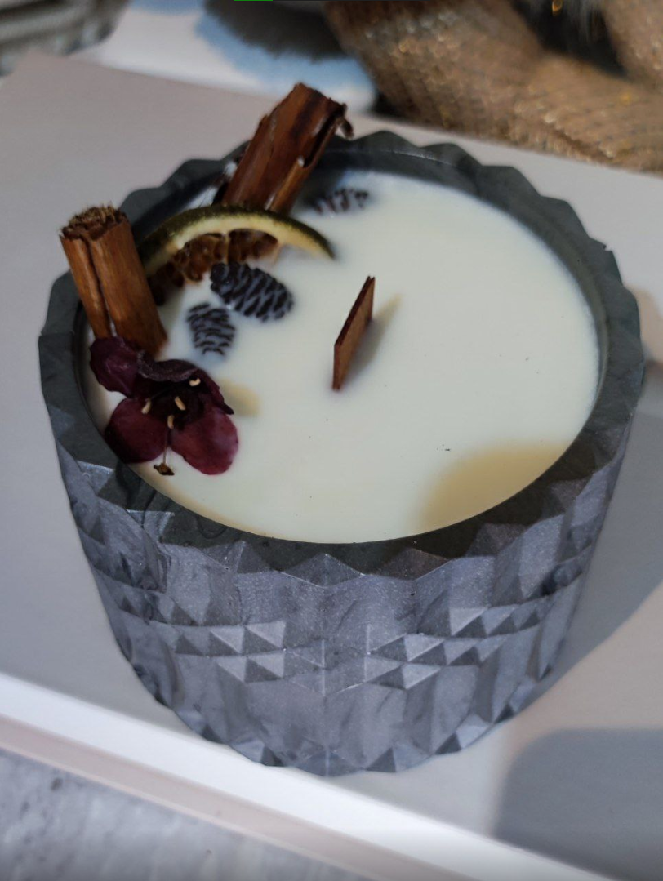
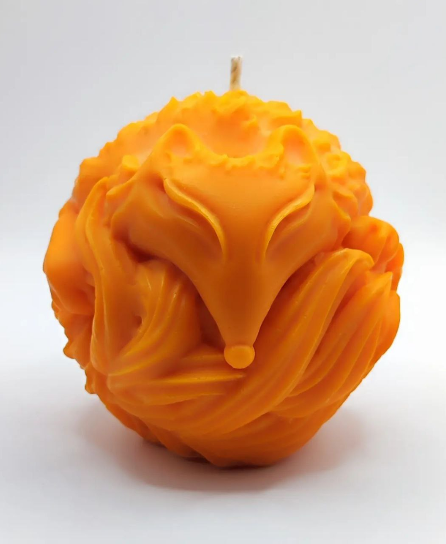
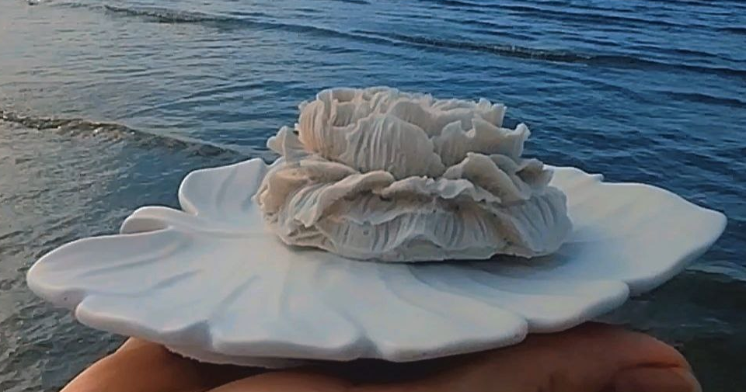
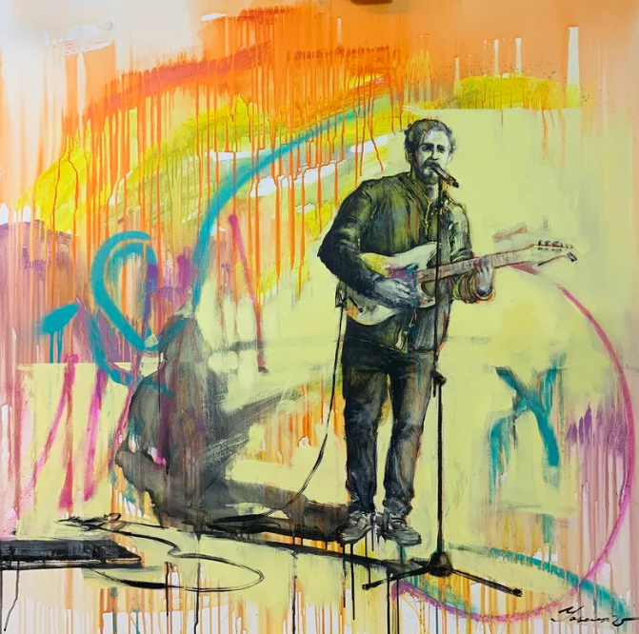
Asset Name | Source link and where is located in the presentation | How It looks like | Asset type | Why you want to use it?
Christmas harmony | https://www.instagram.com/my_candle_for_you_/?utm_source=qr&igshid=OGU0MmVlOWVjOQ%3D%3D I use this image in Craft and shop page on slide 10 and 8. |  | Image | This is one of the best candles Khrystyna has ever made, I love it so much so I posted it here
The Fox | https://www.instagram.com/my_candle_for_you_/?utm_source=qr&igshid=OGU0MmVlOWVjOQ%3D%3D I use this image in Home and Craft page on slide 7 and 10. |  | Image | An example of a candle that is beautiful and cheap at the same time, despite the low price it is quite well detailed so I added it.
White petal | https://www.instagram.com/my_candle_for_you_/?utm_source=qr&igshid=OGU0MmVlOWVjOQ%3D%3D I use this image in Home and Craft page on slide 7 and 10. |  | image | Since Khrystyna makes more than just candles, I thought I'd show some of her other work here as well.
Street musician | https://www.singulart.com/en/artworks/yaroslav-yasenev-street-musician-1010861 I use this image in Arts, Shop and Home page on slide 10, 8 and 7 |  | Image | It’s a one of most popular Yaroslavs work so I decided to show it here.

Slide 5

Asset Name | Source link and where is located in the presentation | How It looks like | Asset type | Why you want to use it?
YAlogo | I took this image from Teams and changed it’s colour to website colour scheme. I used it on slide: 2 and 7-15 |  | Image (logo) | Because it is a logo of Young Artists Association so I need use to it.
I deleted “YAmap” form my asset list because I used script to include a real map into my webpage.

Slide 6
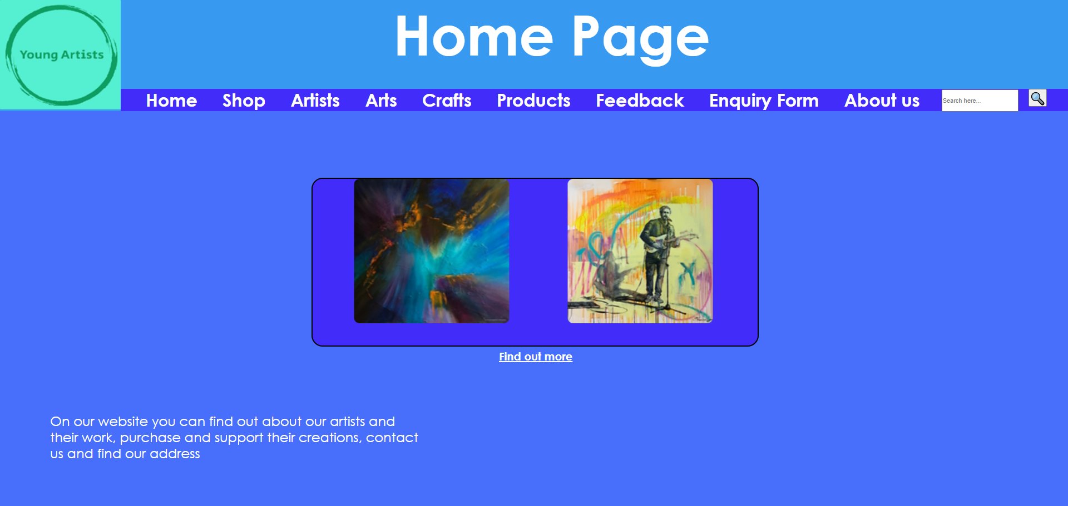
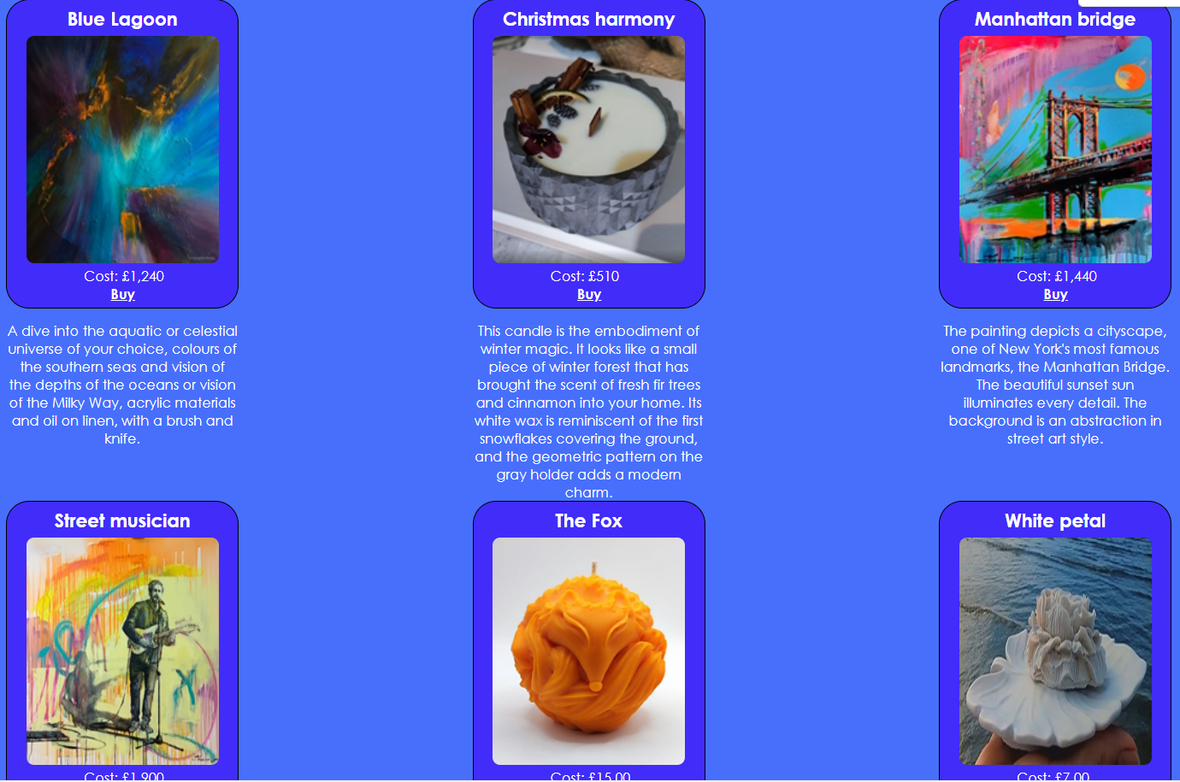

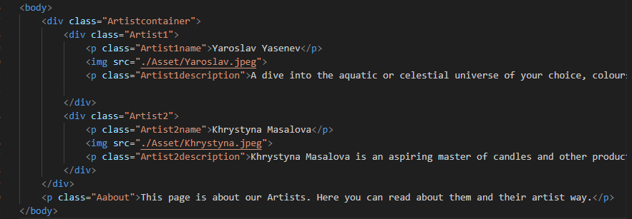
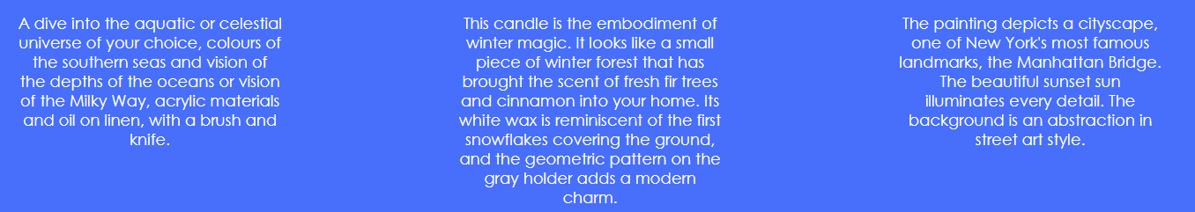


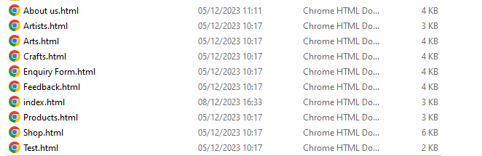

No | Page | Test description | Expected Outcome | Actual Outcome | Evidence | Comments/User Requirement
1 | All pages | Page loads (Including speed load (1-2 seconds) | The page loads fast ( + when I open it. | The page loads for 1-2ms or even less. |  | In order not to bore the user with loading, I have to make the loading optimized and fast.
2 | All pages | Images work (including logo) | The images all display correctly. | All images display correctly |  | Since my site is about artists the images should be displayed without any errors so that users can look at the work of artists.
3 | All pages | Navigation bar links work | The navigation bar links all link to their relevant pages. | The navigation bar links all link to their relevant pages. |  | The navigation bar is the only way to move between pages so it should work without any errors.
4 | All pages | Images have alt (including logo) | All of the images contain alt text in the image tag. | No alt in “Artists” page |  | For users with poor internet connection it is necessary to embed alt text so that they can understand the meaning of the images.
5 | All pages | Spelling and grammar correct | All spellings and grammar are correct on the webpage. | All spellings and grammar are correct on the webpage. |  | To avoid misleading the user, the text should be written without mistakes
6 | All pages | Text display | All the text displays as was planed (Correct size, style, colour and font) | All the text displays as was planed (Correct size, style, colour and font) |  | For the convenience of the user, the text should be on a recognizable background and have a normal style and font.
7 | Entire website | Does the website have 8 pages | Website should have minimum 8 pages | Website has 10 pages |  | A minimum of 8 pages is required to complete all information and site features.
8 | All pages | Do all pages contain logo | All pages must contain logo | All pages contain logo |  | The user must be able to see the logo to understand what page they are on.

Slide 7
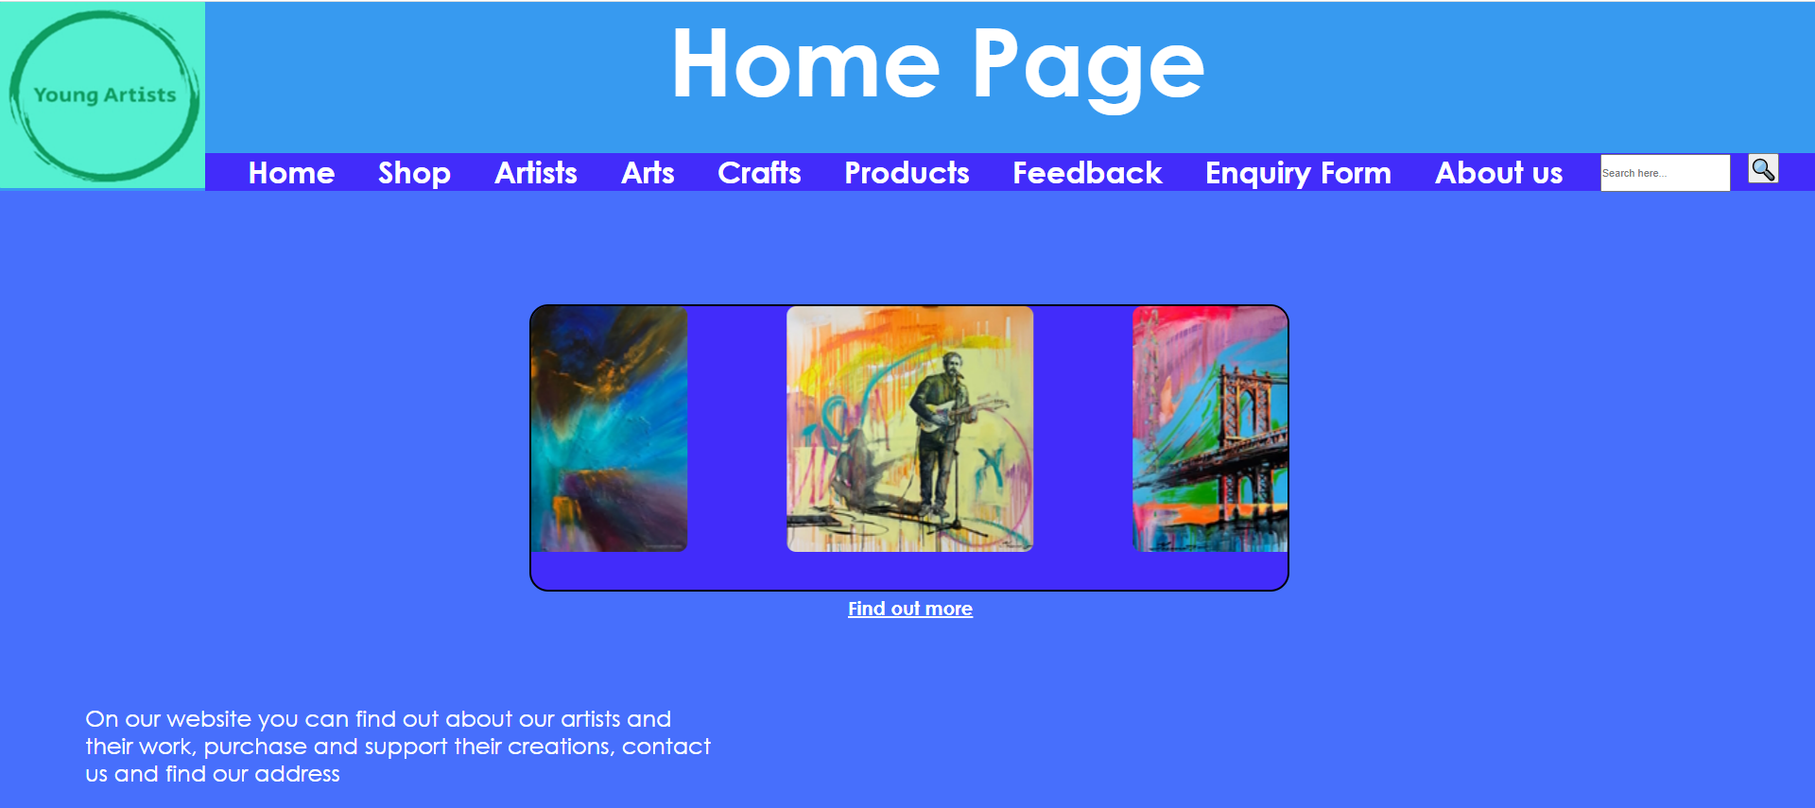
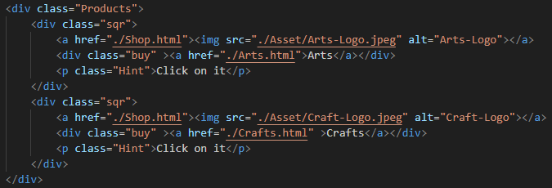
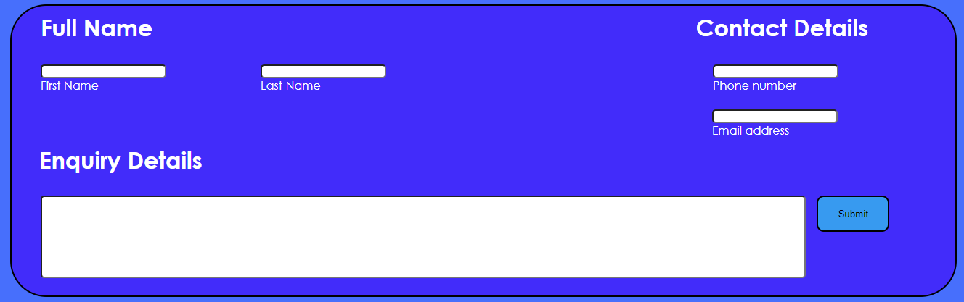
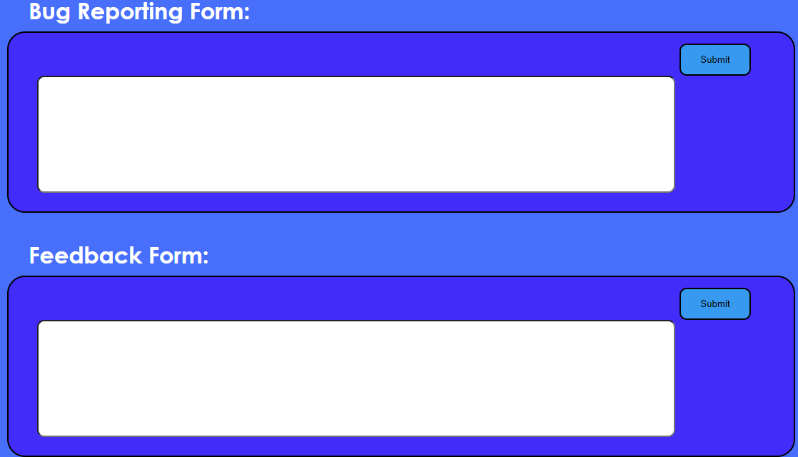
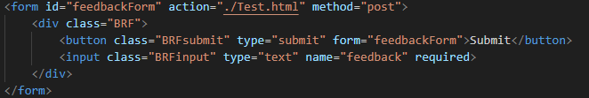
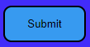

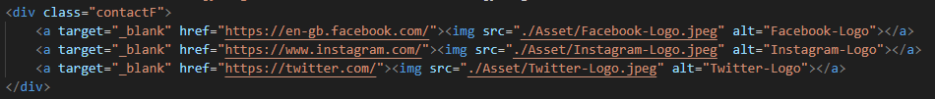
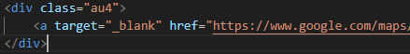
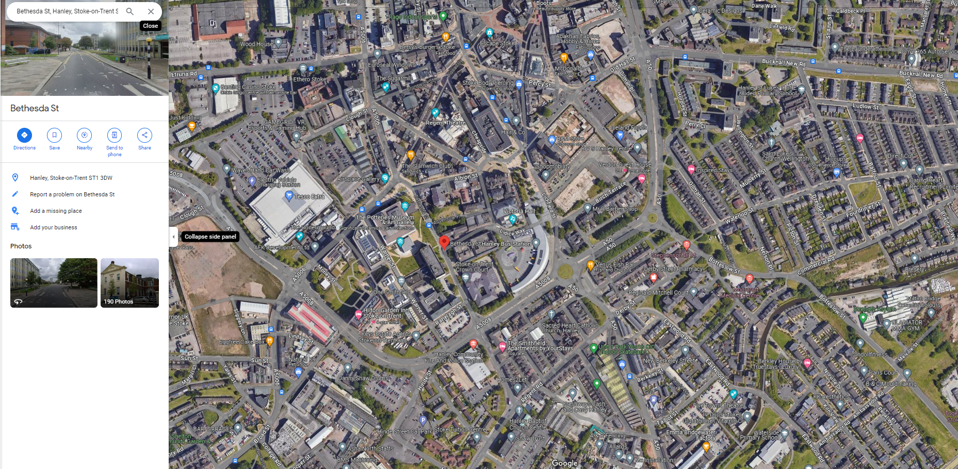
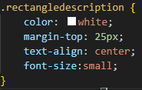
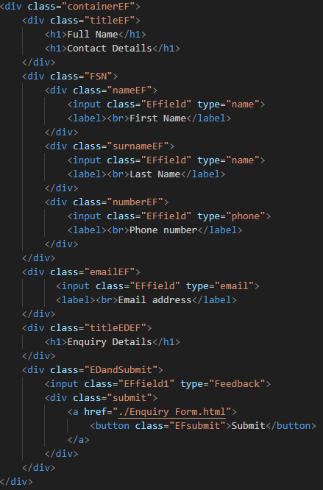
No | Page | Test description | Expected Outcome | Actual Outcome | Evidence | Comments/User Requirement
9 | Home page | Does the home page have slideshow and if yes, does it work? | It does and it works | It has slideshow |  | To unobtrusively show the user the number of works by the artist.
10 | Product page | Links check | links link to relevant pages (Arts and Crafts) | Arts and Crafts lead to Shop page, but should to Arts and Crafts |  | The user expects working links to the relevant pages.
11 | Feedback and Enquiry form page | Form check | Ability to fill out forms | You can fill this forms |  | The user should be able to contact the administration in case of questions.
12 | Feedback and Enquiry form page | Button check | The submit button should be clickable. | It is clickable and lead to other page. |  | The user expects everything they write to reach the staff.
13 | Feedback and Enquiry form page | Do links to social media work | Links should lead the user to the appropriate social media sites | It leads the user to the appropriate social media sites |  | The user is expected to be able to follow the association through social media and receive news from there.
14 | About us | Map link check | The link should lead to google maps (In new tab) | It leads to google maps (in new tab) |  | So that the user understands where the Young Artists Association is located.
15 | All Pages | Accessibility check | Readable text on all pages | Most of text is small so user cannot read it. |  | All text should be readable And understandable for people
16 | Enquiry form | Data Validation | Name and Surname field must include only letters, email must include “@” and the phone number must include only digits. | Data Validation doesn’t work at all. |  | If user won’t put “@” in his email, the staff won’t receive the email. The same with phone number. If phone number will be with the letter, staff won’t be able to call. The same with Name and Surname because if user will put “123” in Name/Username field, staff won’t know how to talk to him.

Slide 8
Test questions to the tester.
1. Spellings and grammars are correct?
Yes it does.
2. Can you fill the forms (Do you understand why not)?
Yes you can.
3. Is all text on the website readable?
It should be a bit bigger for people who have trouble reading small writing .
4. Does the slideshow looks normal (Does it work normally?)
Yes it works great.
5. Do all pages load fast? (No freezes?)
They work.
6. Does form have a Data Validation?
It doesn’t. Kyryl need to add Data Validation.
I need to make text bigger.
I need to add Data Validation in my forms.
Answered by Jake Finney

Slide 9
Test questions to the tester 2.
1. Do all images have alt?
No, images in Artists page do not have alt.
2. Do all links work and lead to relative pages?
No, Arts and Crafts divs on the products page lead to shop page.
3. Does map link work (leads you to the google maps)?
It does work.
4. Do all images work and display correctly?
They are.
5. Do submit buttons work?
They do
6. Does slideshow work?
It works and it looks nice.
I need to add alts to the Artists page
I need to fix links on the Product page.
Answered by Layton Woodward

Slide 10
User Feedback
Make the header width smaller so the user can see where the header starts and ends. This way he will not look for additional buttons and will realize that this is the start/end of the header.
I need to make the headers start and end more visible
Feedback from Steph Tague

Slide 11
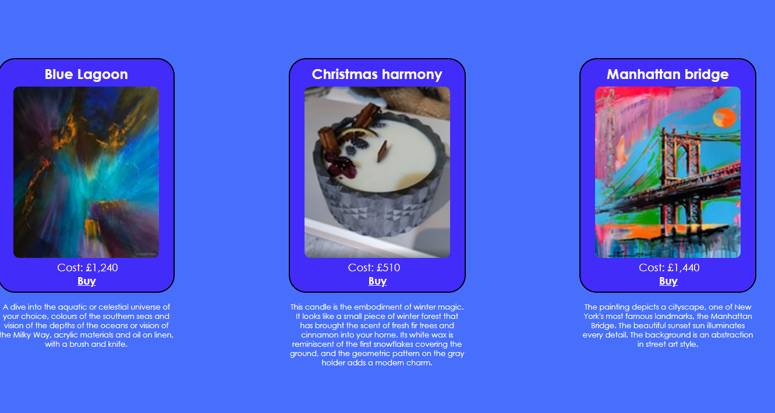
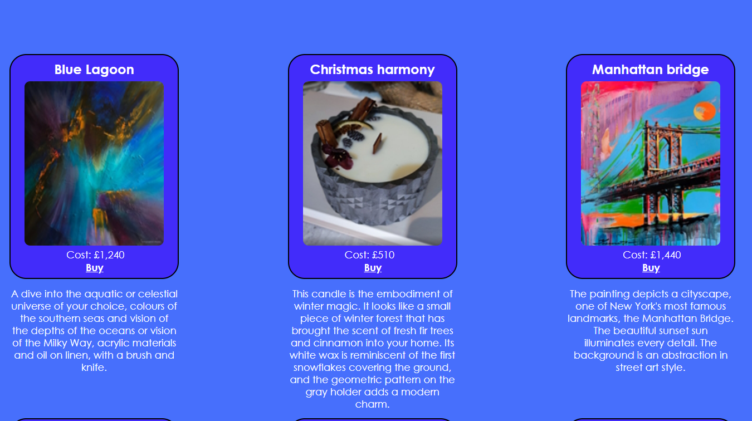
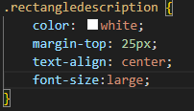
Making Text bigger
Before
After

Slide 12
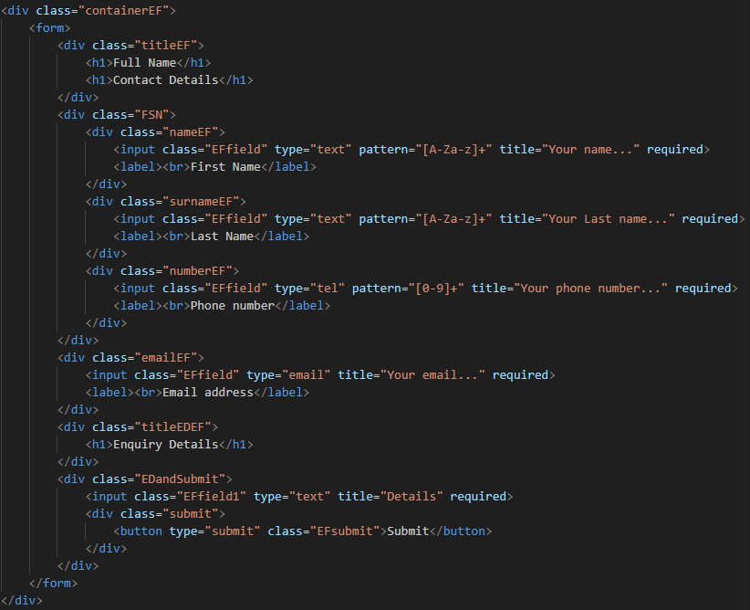
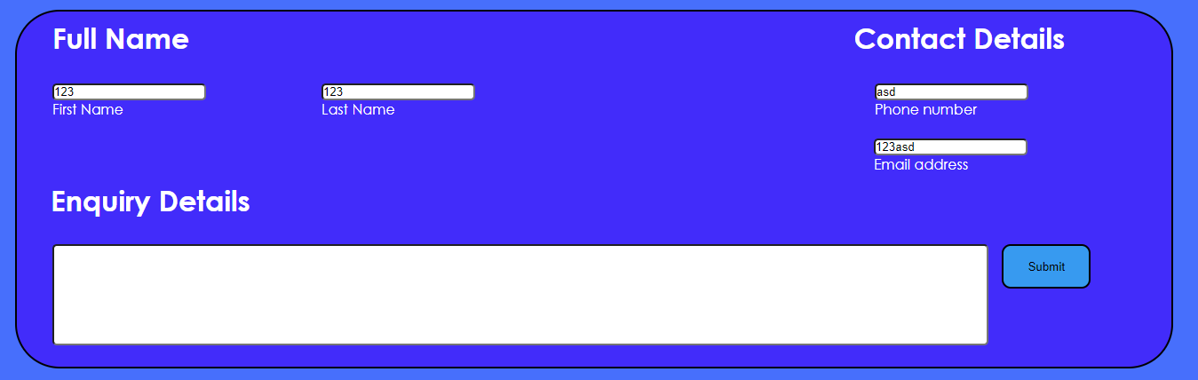
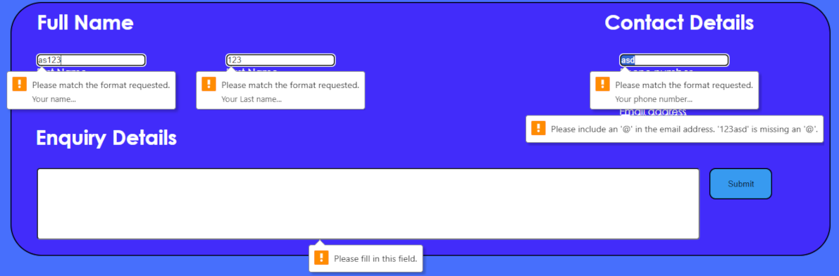
Making Data Validation
Before
After
Before
After
Code
Form

Slide 13
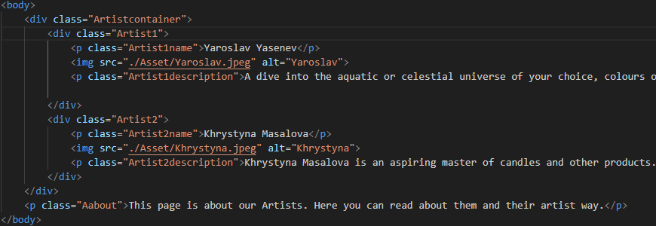
Fixing alts on the Artists page
Before
After
I added 2 alts and now it works:

Slide 14
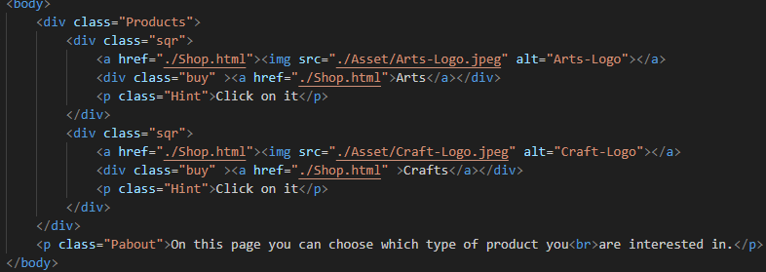
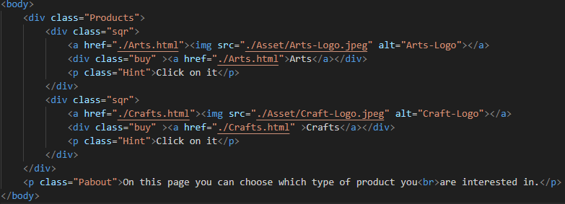
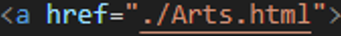
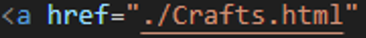
Fixing Arts and Crafts link on the Products page
Before
After
Now links lead to relevant pages and everything is ok

Slide 15


Making headers start and end visible.
Before
After
Now user can see where header start and ends

